Slide 1
Final Presentation - Ingestion of Common Microplastics
Dalton Blackwell, Amelia Ehlers, Andy Gardner, Kyle Guevarra, Jasper Nevis

Slide 2
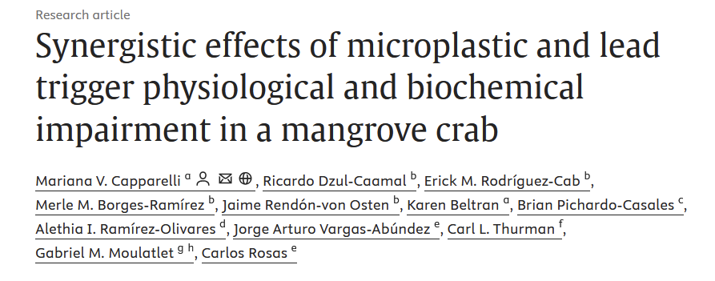
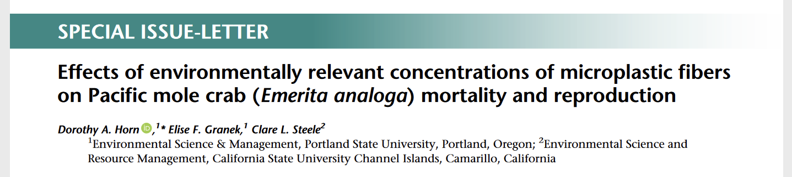
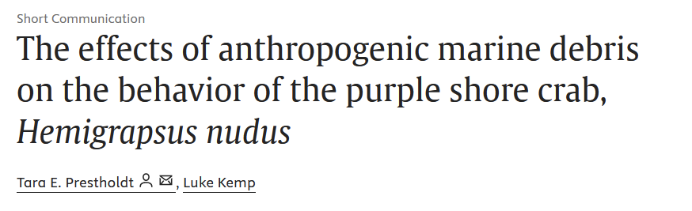
Background: Microplastics in Crabs
Impacts of exposure to microplastics:
Mangrove crab (Capparelli et al. 2024):
increased accumulation of lead
Pacific Mole Crab (Horn et al. 2019):
increased adult mortality
decreased retention in egg clutches
Purple Shore Crab (Prestholdt and Kemp 2020):
Avoidance of plastics
Notes:
Amelia
MP accumulation and lead in combination lead to higher oxidative stress.
Decreased retention leads to more variation of embryonic development
While they may be able to avoid the worst effects of the presence of plastics, such as chemical leaching, avoidance in an environment that has increasing accumulation of plastics may impact the behavior of the purple shore crab
Additionally, the presence of microplastics has wider effects up the food web on the organisms that prey on crabs.

Slide 3
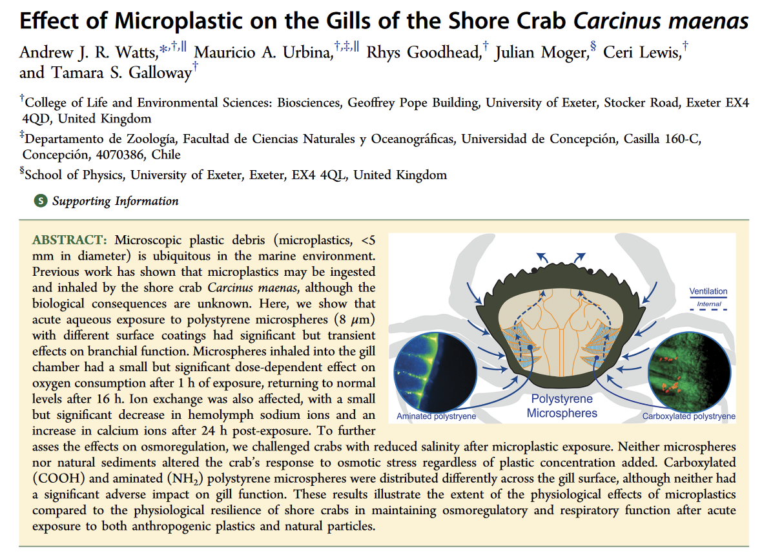
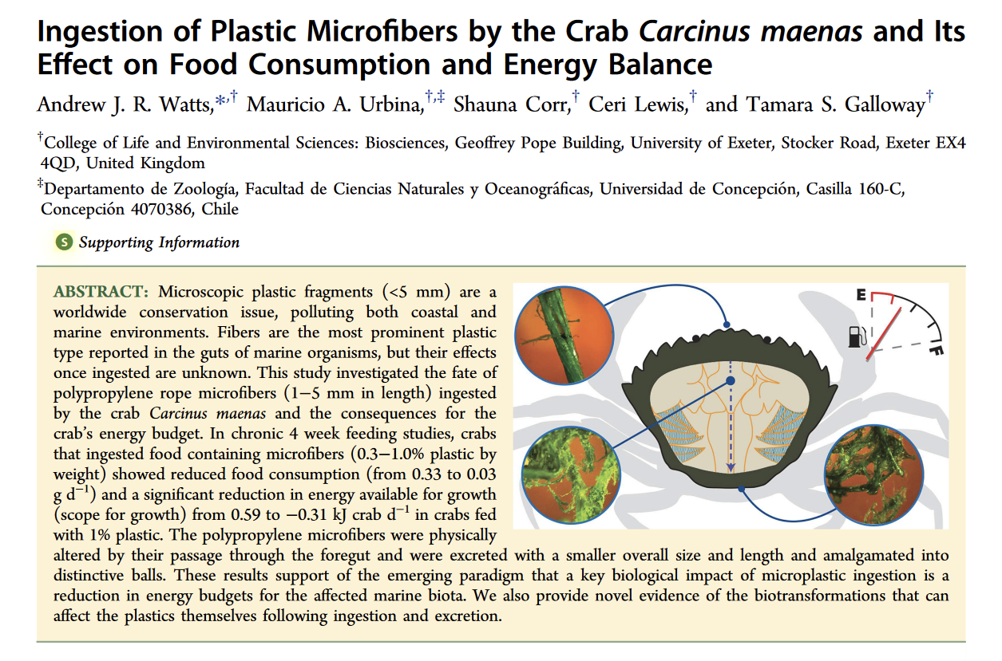
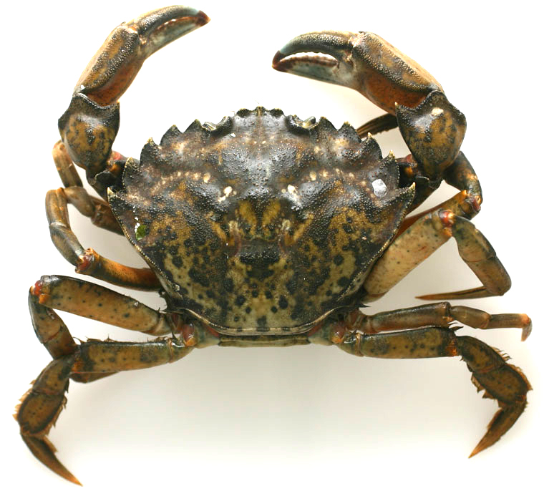
Background: Microplastics & Invasive Species
Notes:
Andy

Slide 4
Research Question:
Do microplastics impact oxygen uptake in hairy shore crabs and/or accumulate in their gills and tissues?
Notes:
Amelia

Slide 5
Objective: Hypothesis & Null-Hypothesis
H₀: No impact of oxygen uptake and microplastics will not accumulate
H_{A}: Decreased oxygen uptake and microplastic accumulation in gut and gills
Notes:
Amelia

Slide 6
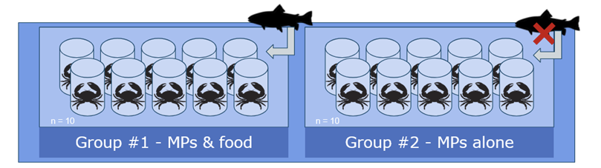
Experimental Design: Set-Up
Notes:
Jasper
2 groups: microplastics and microplastics + food, 10 replicates in each group
All microplastics scented with mussel juice
2.5mg microplastics to each group, 2.5g mussel meat to fed group
13 C, 30 ppt water

Slide 7
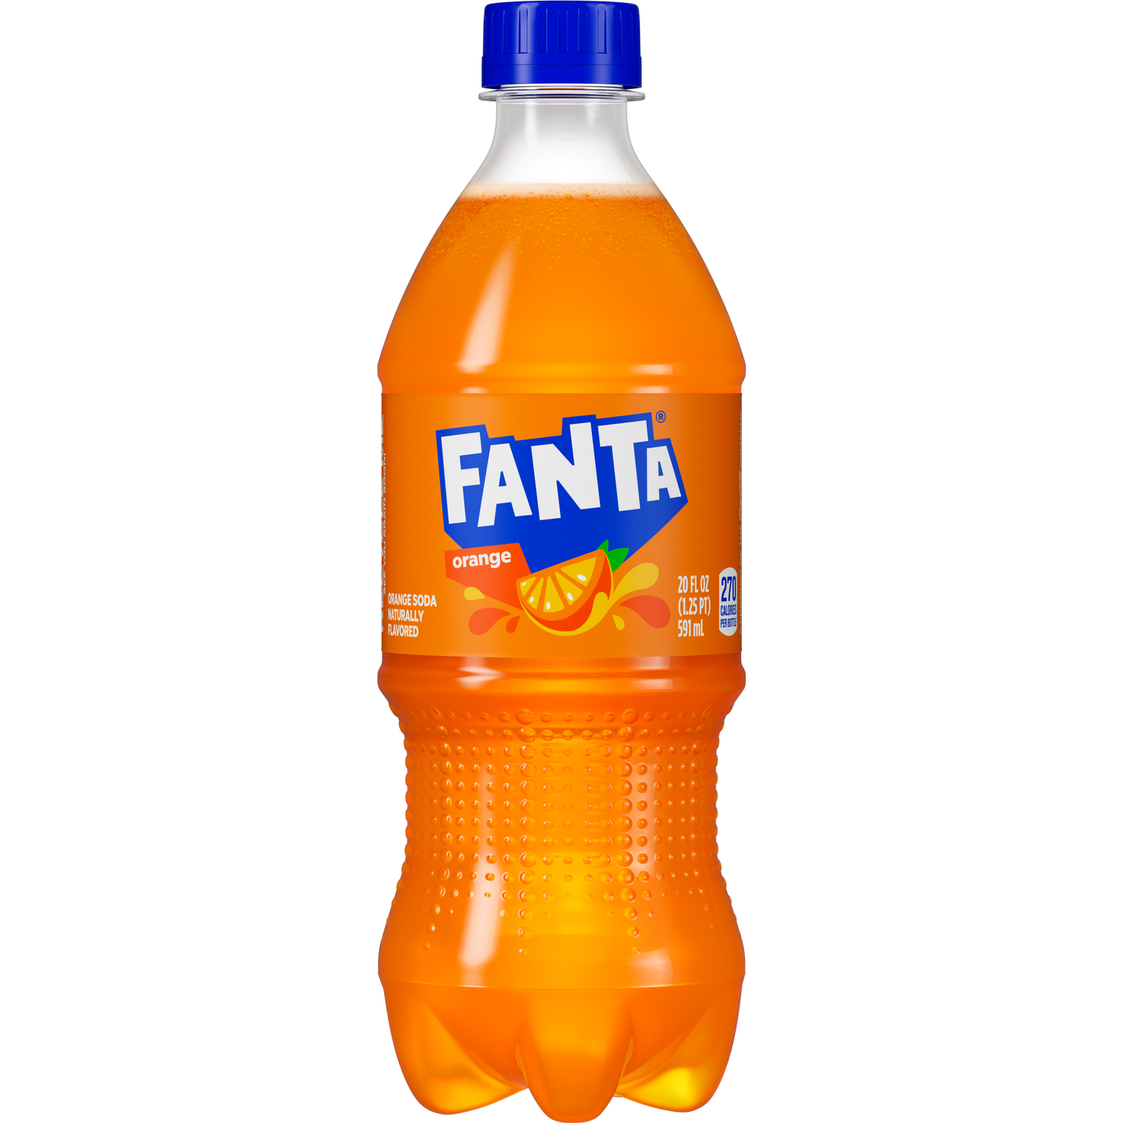
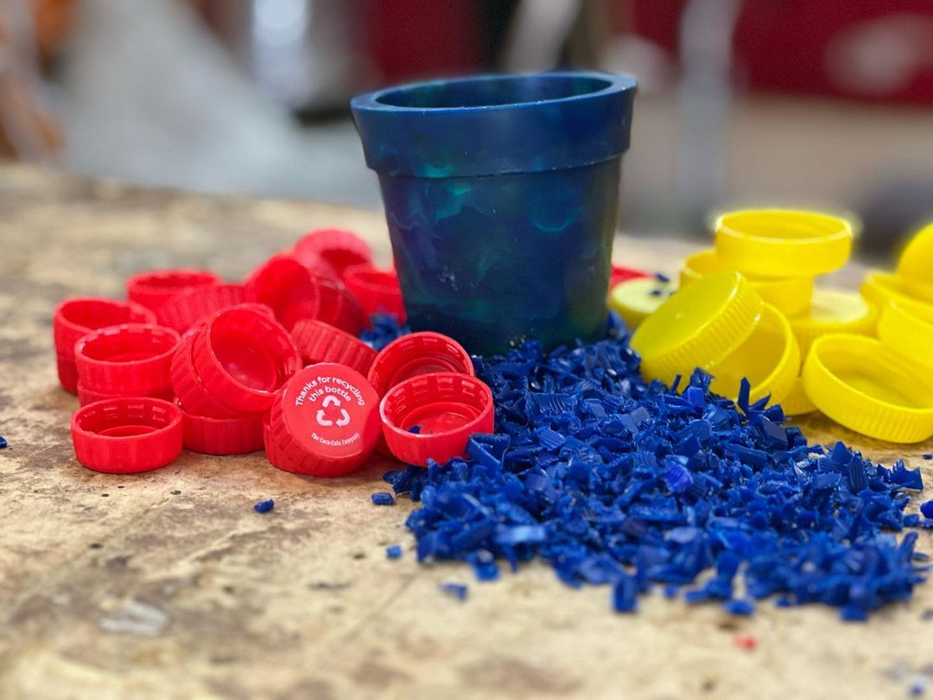
Experimental Design: Choice of Plastic
“Recycled” plastic, simulating what’s available in the water column rather than a specific isolated type of plastic.
Blue color easily visible against beige crab tissues
Notes:
Andy

Slide 8
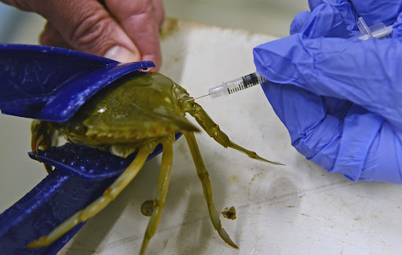
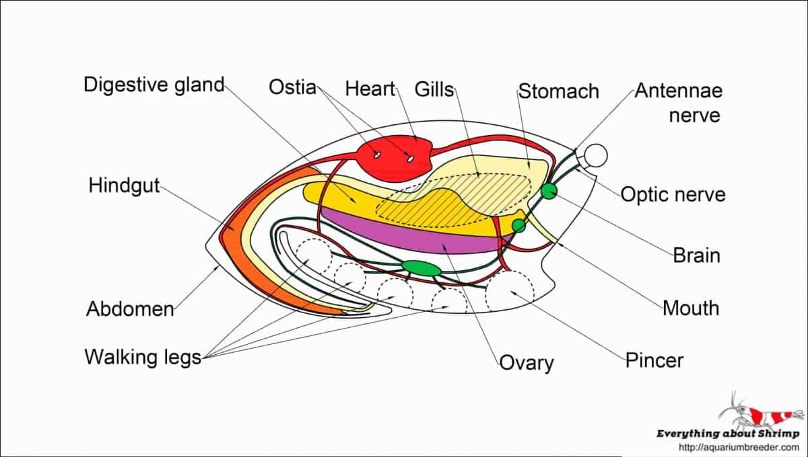
Experimental Design: Data Collection
Claw hemolymph extracted- tested for L-lactate concentration
At end of experiment, all crabs weighed & dissected
Examining digestive tract & gills for plastic particles
Notes:
Jasper

Slide 9
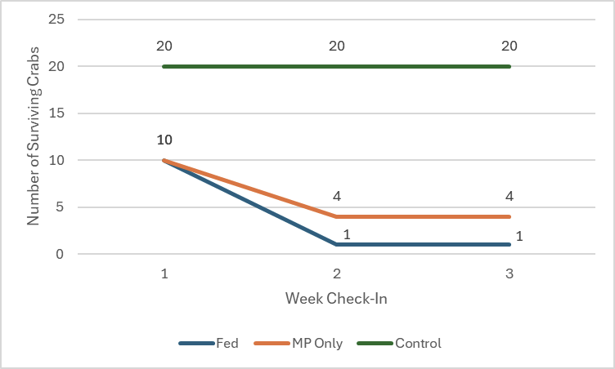
Complications & Adjustments
Mass mortality event
Group A: 60% Mortality Rate
Group B: 90% Mortality Rate
Causes
Hypoxia: Low Oxygen saturation due to restrictive water flow
Ammonium Toxicity: Toxic compounds from decaying food matter
Adjustments
Transition from individualized jars to communal tank setups
All MP and food matter was also transferred into the tank setups
Notes:
Kai

Slide 10
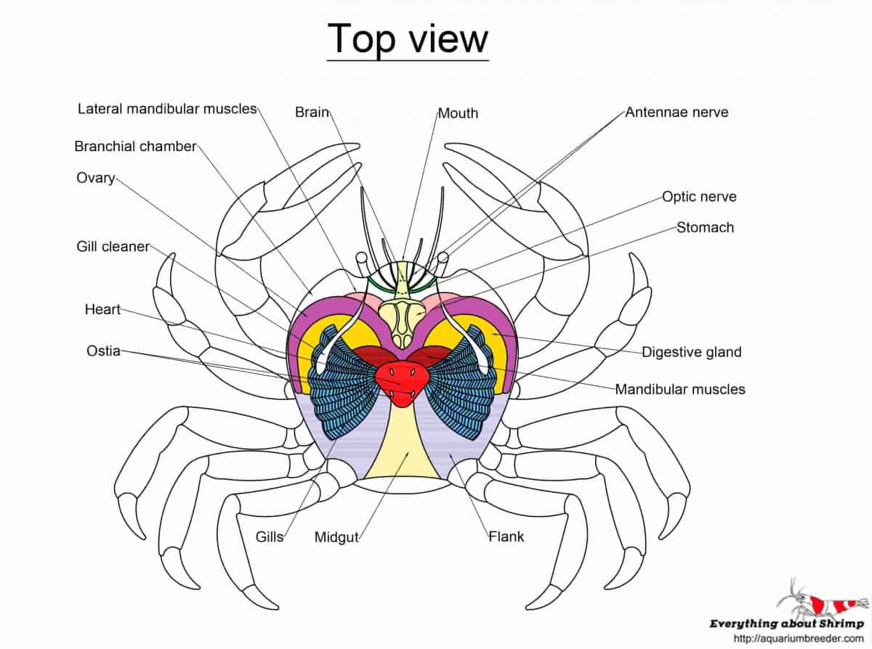
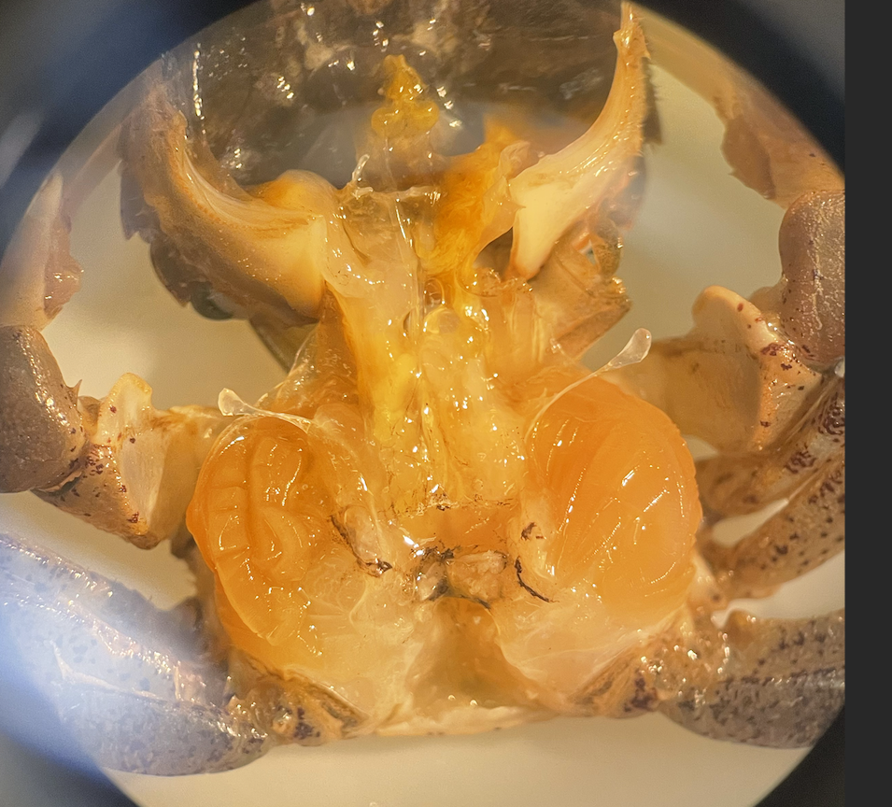
Dissections & Accumulation
Stomach
Gills
Hindgut
Notes:
Jasper

Slide 11
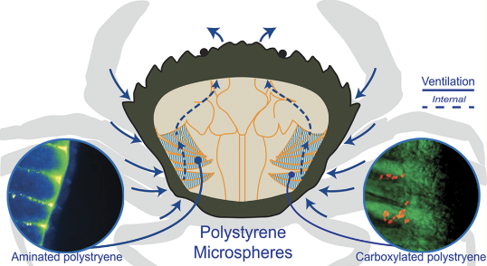
Comparison to Green Crabs
No accumulation,
unable to compare to C. maenas
Watts et al. 2016
Notes:
Andy

Slide 12
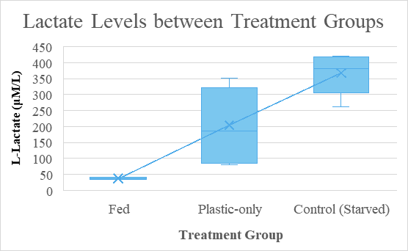
Lactate
Control groups - Group FOUL and Group CAFF
Average ~ 300 micromolar lactate
Experimental group
Group PLAST - Fed: ~40 micromolar lactate
Group PLAST - Fast: ~200 micromolar lactate
Control groups and PLAST Fast had larger sample sizes (Between 3 to 5 crabs per sample group)
Notes:
Kai

Slide 13
Implications
Pilot studies are important
Fully communal tank design vs. individual jar design to minimize hypoxia and nitrogen toxicity
Collect behavioral data
Perform water changes daily as opposed to a bi-weekly structure
Allows for prompt diagnosis of novel issues
Dead crabs can be preserved faster to prevent internal organ decay & loss of specimen for visual analysis
Data Analysis
Small sample size implies less conclusive findings
Mortality caused limitations on what assays could be done
Notes:
Kai

Slide 14
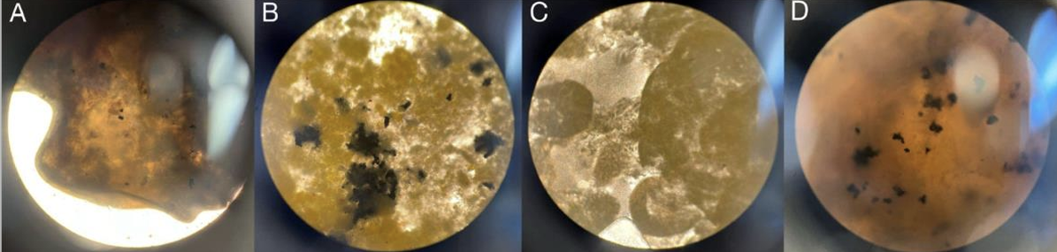
Implications
Fed individual had lower lactate than both control and plastic only group.
Lactate is proportional to anaerobic respiration, which is a stress response
Possible reasons:
Low Fed
Reduced food stress
Hearty individual
Higher MP
Particulate stress
HDPE toxicants
Lack of consumption compared to FISH 497C Tire Tread Team 2024
Our HDPE was…
Buoyant
Colored brightly
Hard and non-porous
Notes:
Dalton

Slide 15
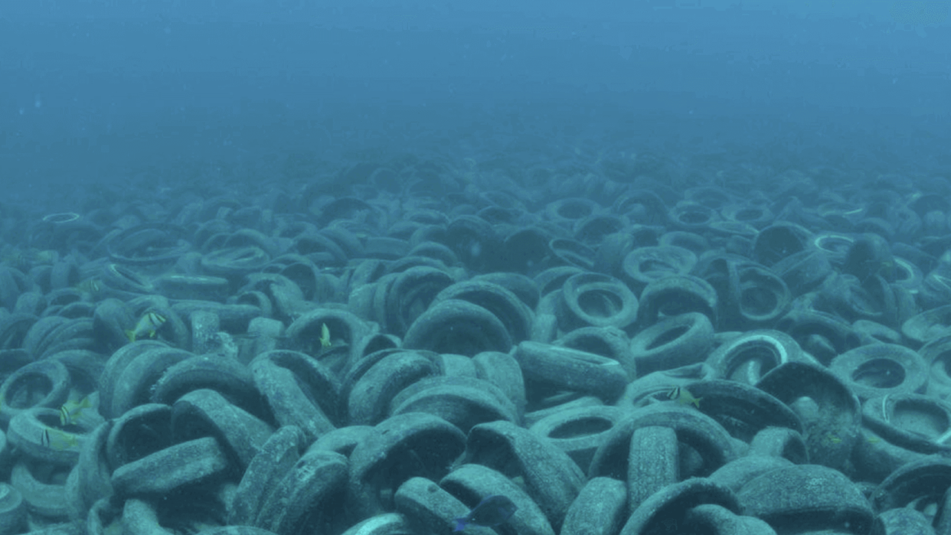
Future
CLASSIFY
PLASTIC A -> SP.A
PLASTIC B -> SP.B
SURVEY
20% PLASTIC A
80% PLASTIC B
PROTECT
SPECIES B > A
Plastic type likely has some impact
Classifying plastics risk, I.E. species specific bioavailability
Allows risk assessment if a pollution survey is conducted
Recycled hard plastics may be less detrimental to crab populations than tire tread
Efforts to reduce runoff from road -> ocean
Prevention/cleanup of tire dumping
Notes:
Dalton

Slide 16
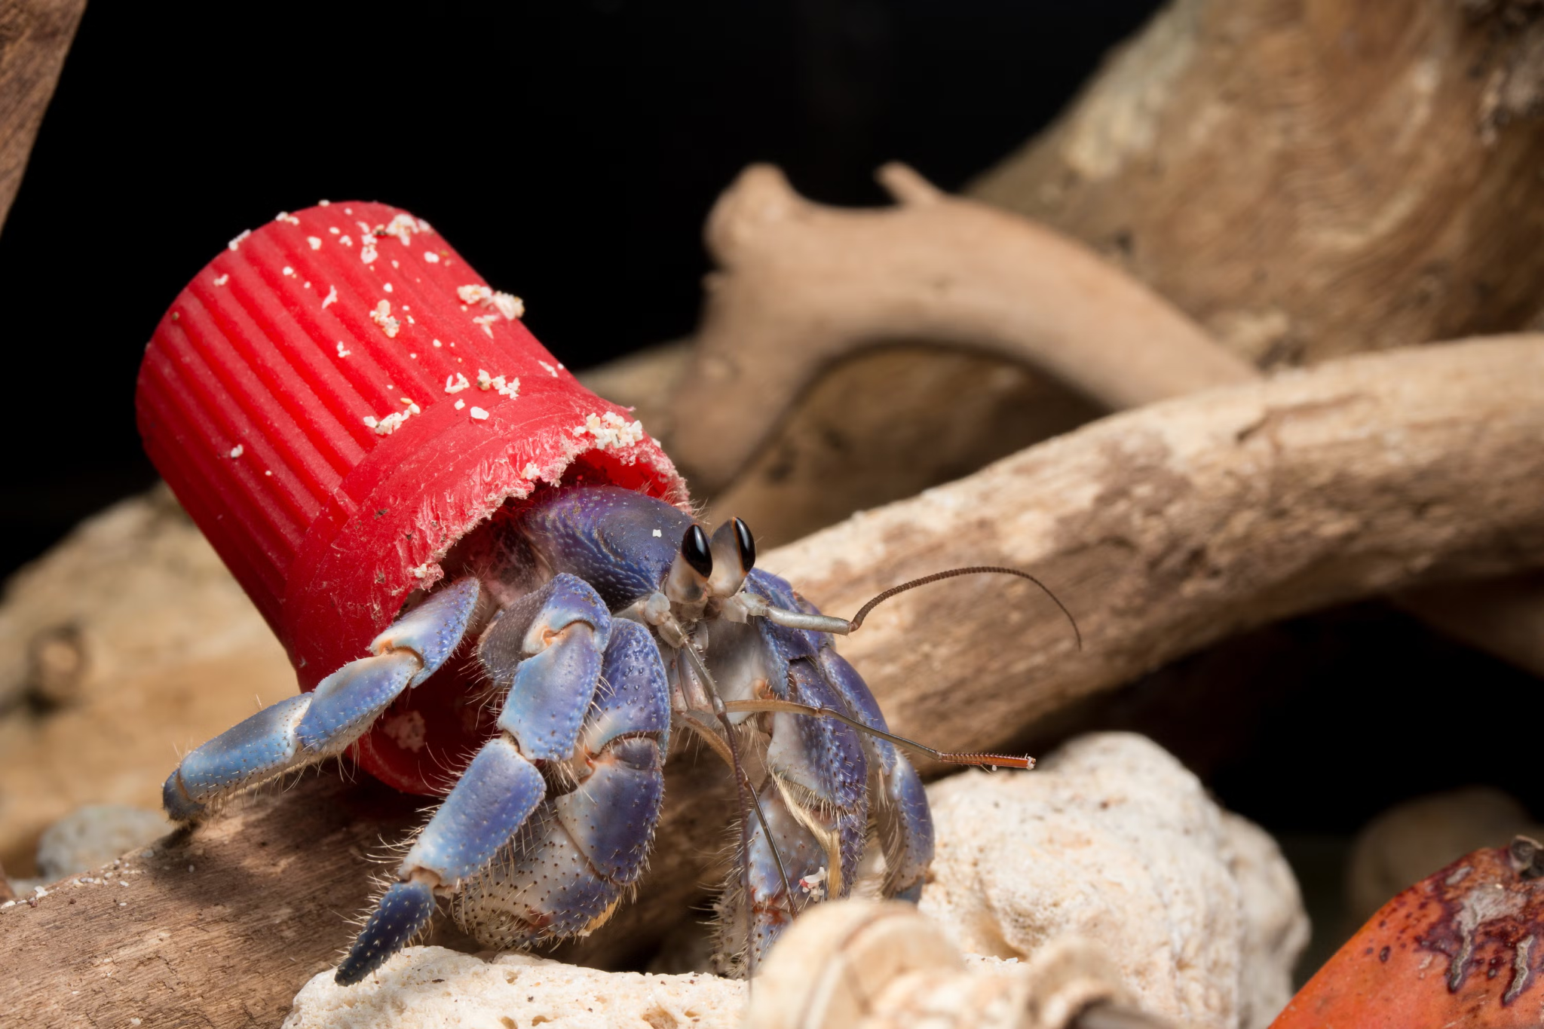
Conclusion
Key takeaways:
Low lactate levels in Fed individual
Lactate = stress
The type of plastic could have an impact in ingestion rates
“Food like” plastic actually consumed
Bioavailability based risk assessment
Notes:
Dalton

